Slide 1

School Management System
Student Name :Farah Mohamed Ahmed Habib ID :243897
Student Name :Sarah Mohamed Ali ID :248097
Student Name :Toni Wagdi Wadie ID:244743
Student Name :Ahmed Hisham Mohsen ID :242435
Student Name :Youssef Mohamed ID :234833
Presented to:Eng. Gehad Ehab

Slide 2
1.CustomDate
Role: Validates date inputs with leap year logic and month formats.
Purpose: Ensures that all date entries are accurately formatted and consistently stored in the database, maintaining data integrity and reliability across the entire application.

Slide 3
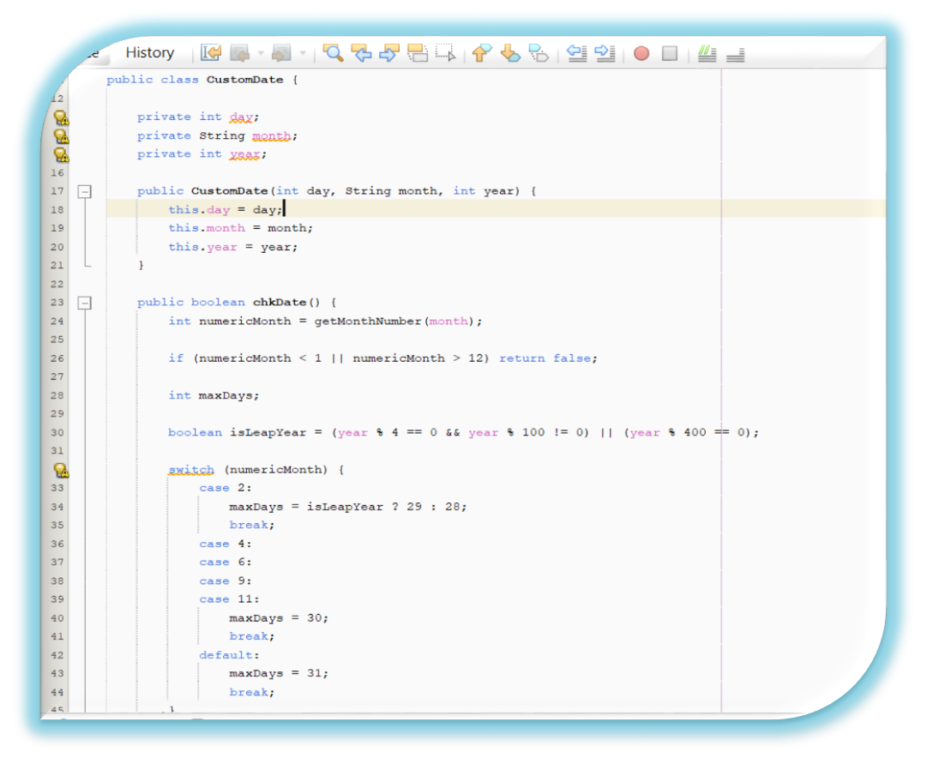
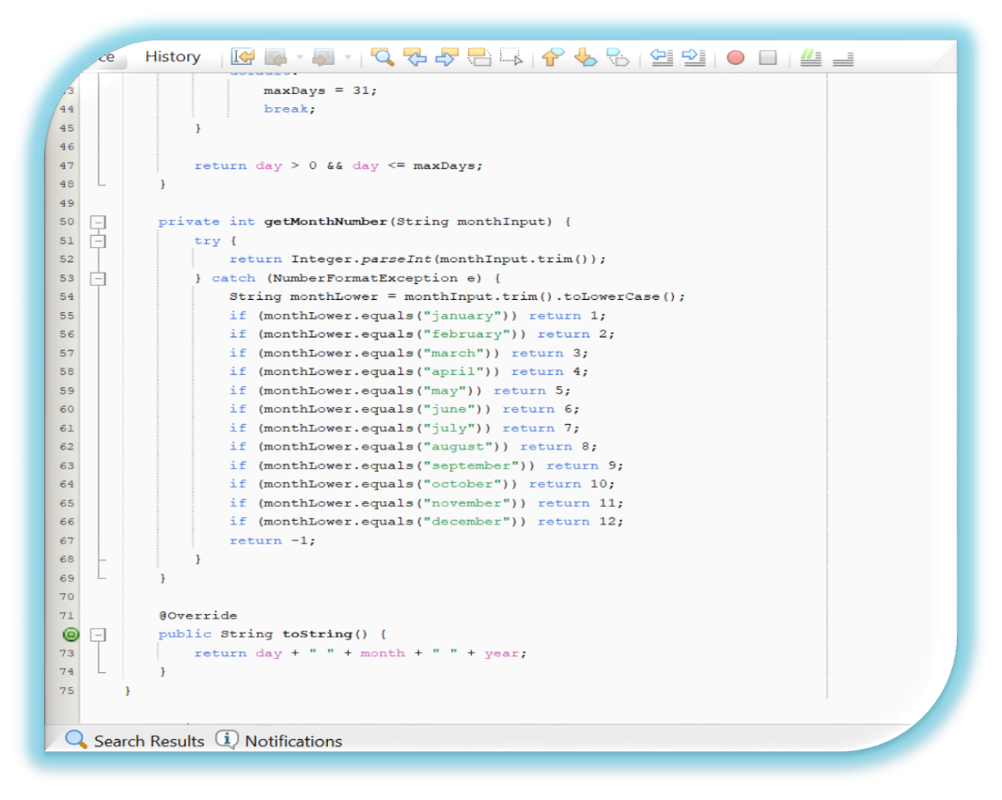

Slide 4
2. DatabaseHandler
Role: Manages database connectivity and performs CRUD operations.
Purpose: Facilitates secure and efficient interactions with the MySQL database through JDBC, enabling the system to handle data operations while protecting against vulnerabilities like SQL injection.

Slide 5
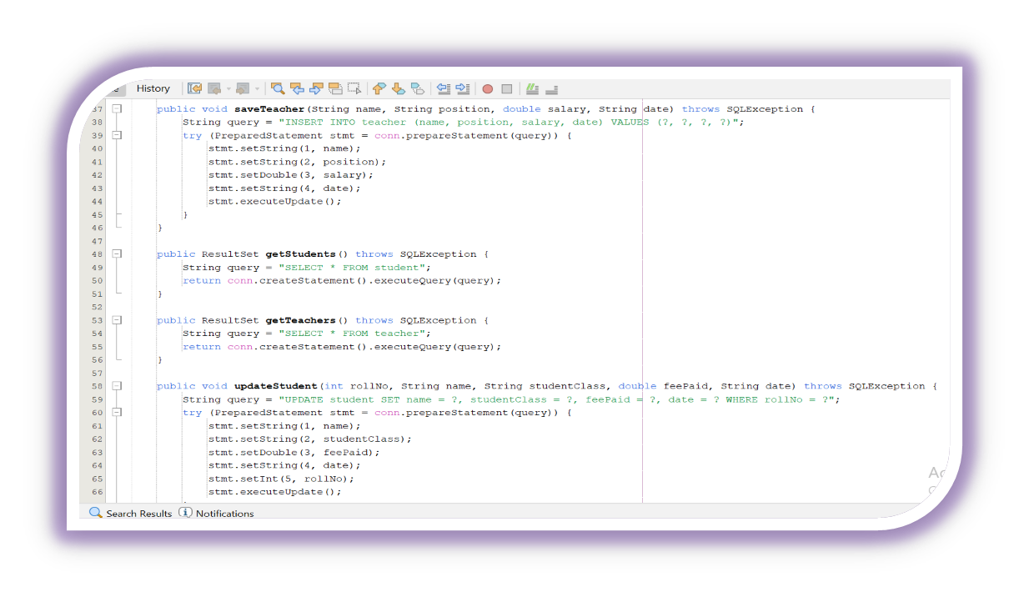
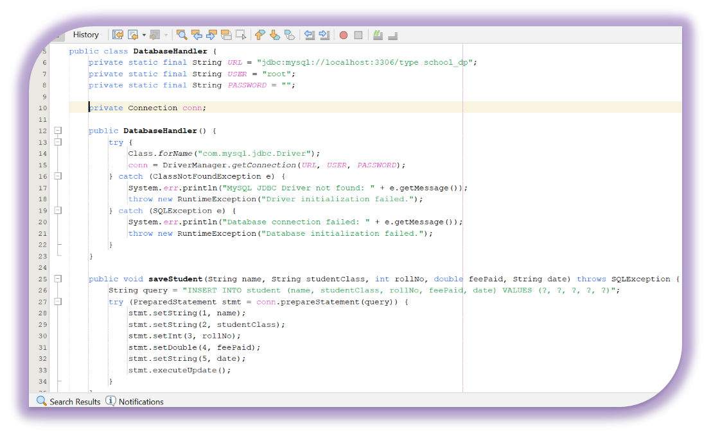

Slide 6
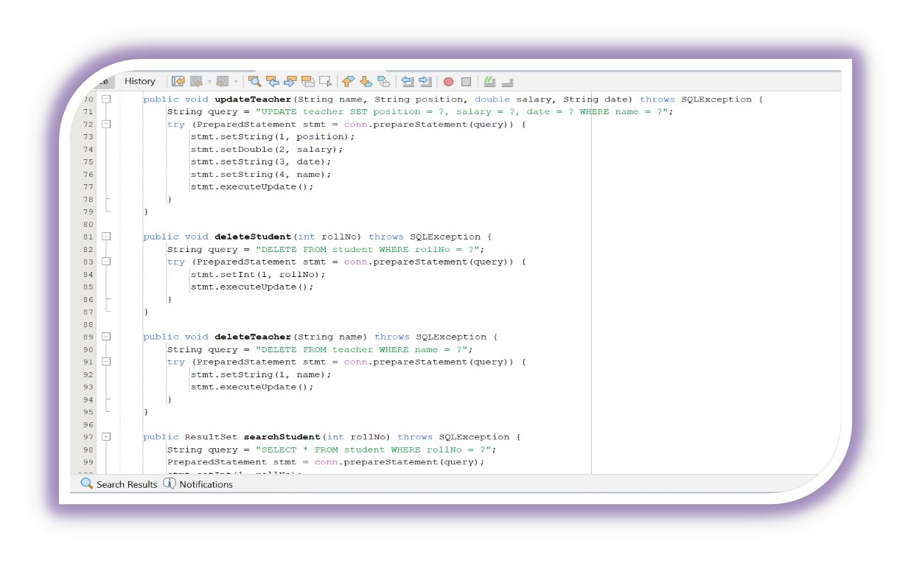
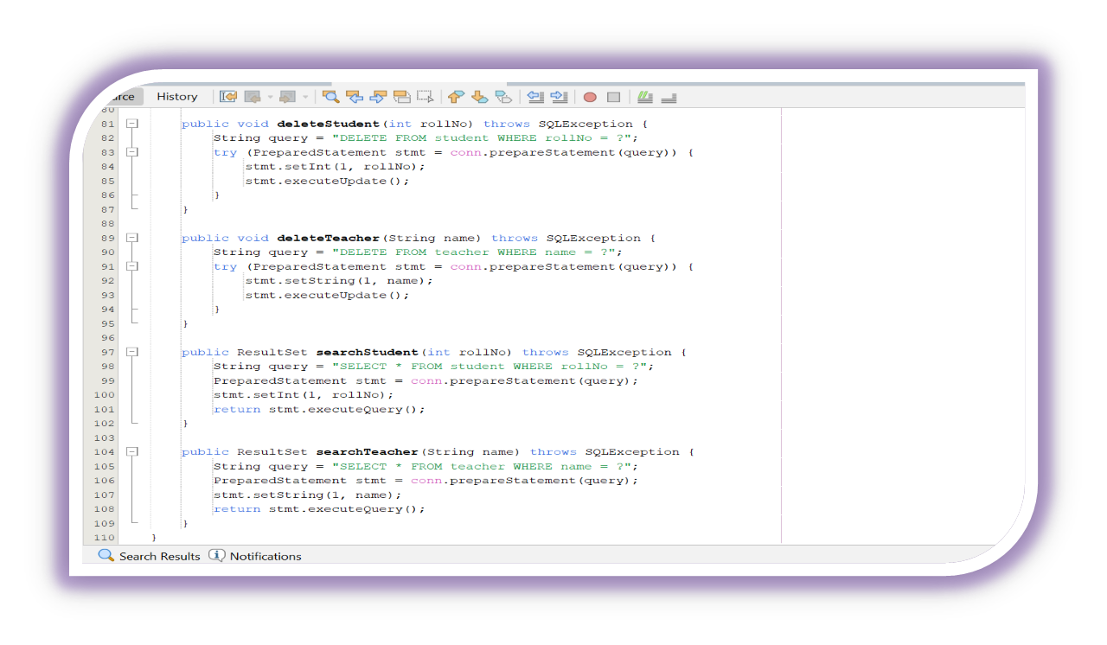

Slide 7
3. SchoolSystemGSE122i
Role: Acts as the entry point with console-based date validation.
Purpose: Validates the initial date input provided by the user and subsequently launches the graphical user interface, ensuring the application starts with a verified foundation.

Slide 8
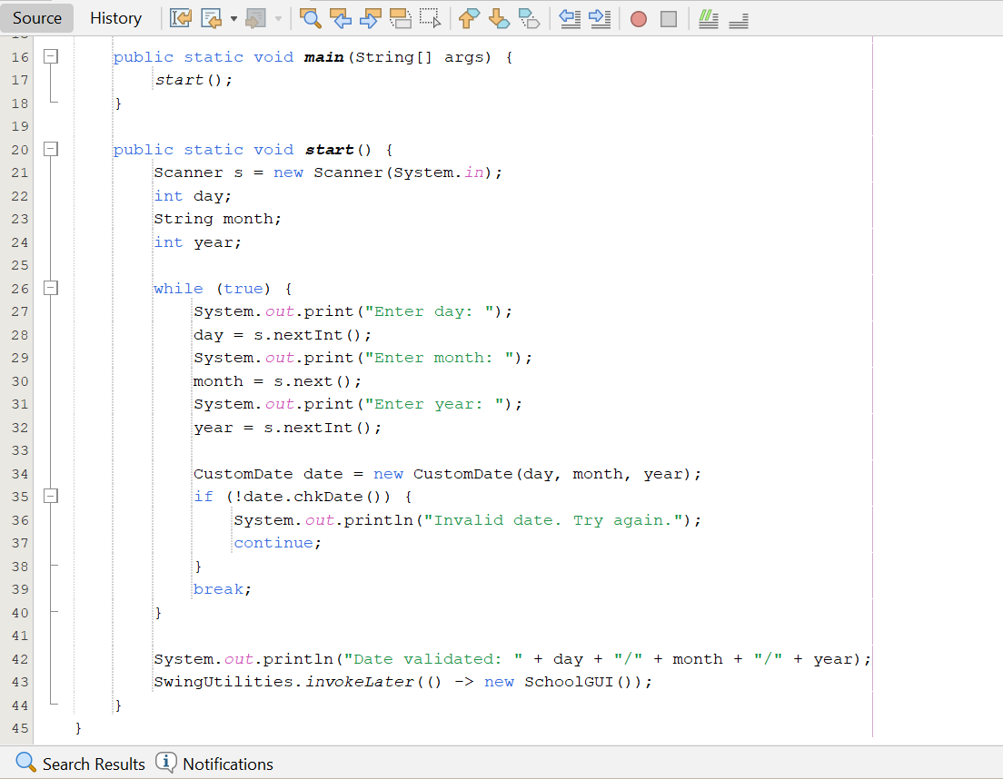

Slide 9
4. SchoolGUI
Role: Displays the main menu with navigation buttons.
Purpose: Guides users to access either the student or teacher management sections or exit the application, providing an intuitive navigation experience to enhance usability.

Slide 10
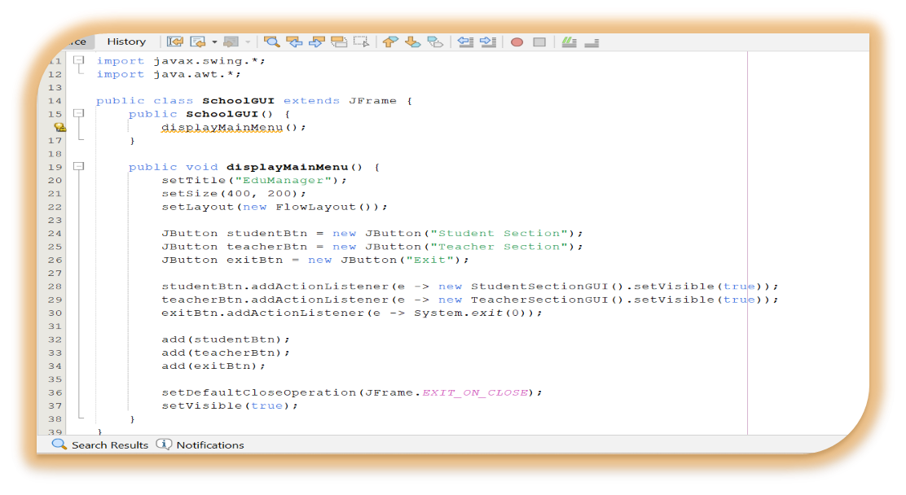

Slide 11
5. Person
Role: Defines an abstract superclass for record management.
Purpose: Ensures consistency in the implementation of record management operations across all derived classes, promoting a standardized approach in the object-oriented design.

Slide 12
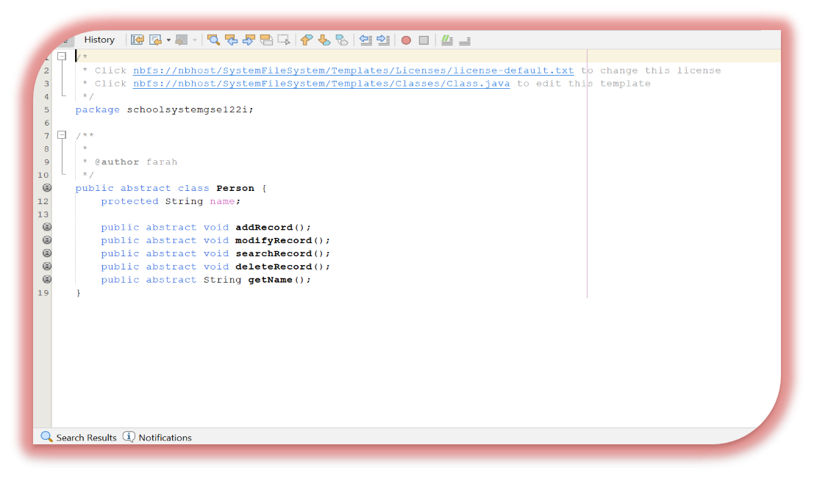

Slide 13
6. Teacher
Role: Manages teacher records, including saving and modifying.
Purpose: Handles the storage, retrieval, and modification of teacher data in the database, supporting administrative tasks like salary viewing and record updates with precision.

Slide 14
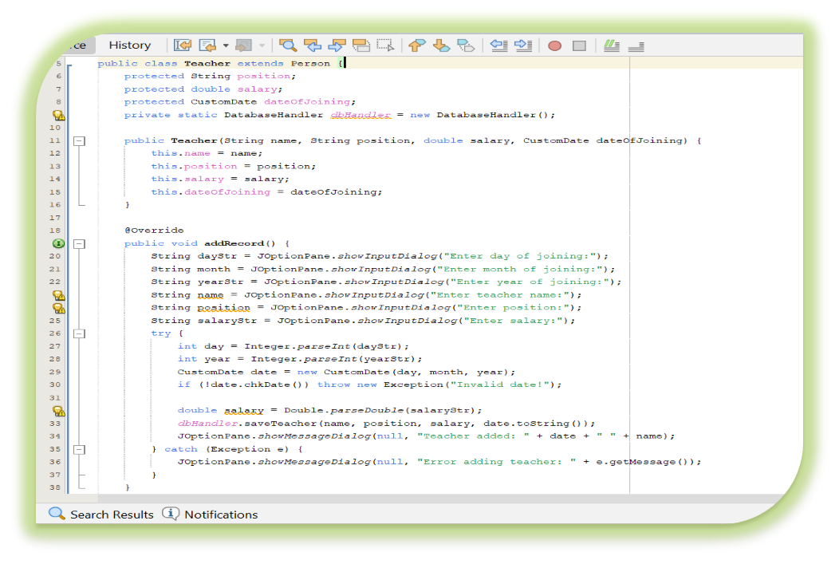
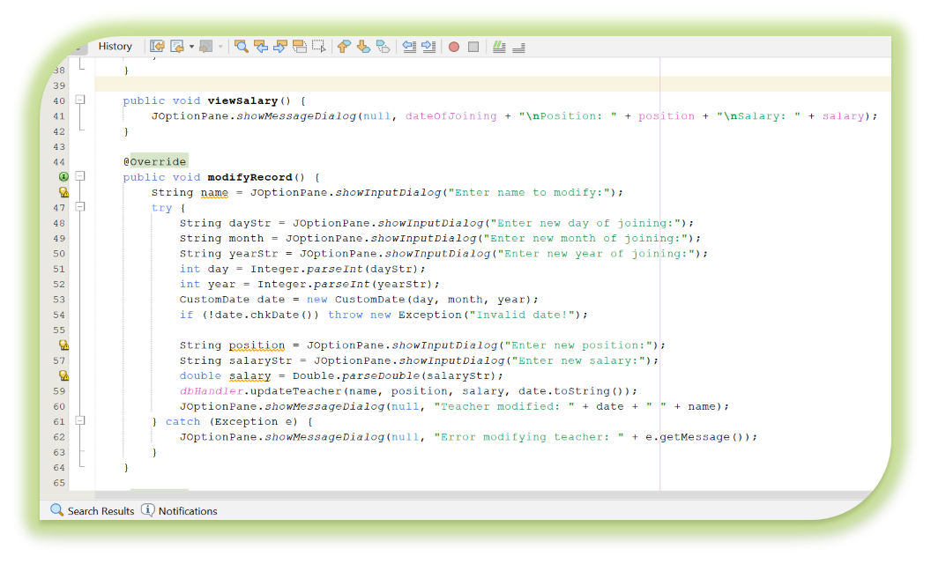

Slide 15
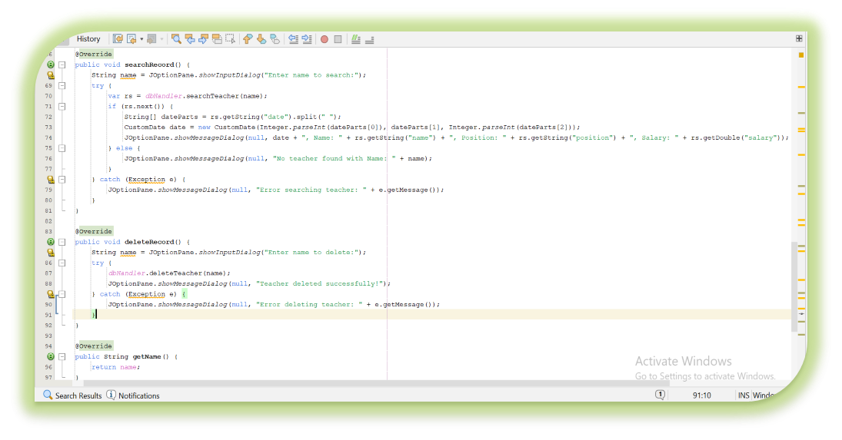

Slide 16
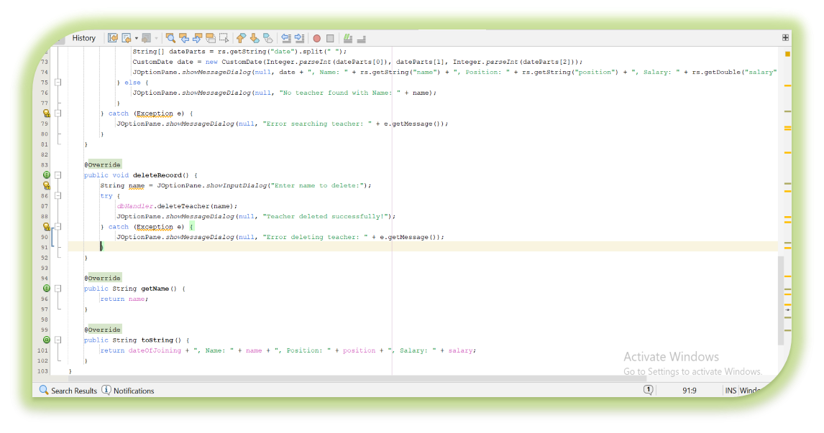

Slide 17
7. TeacherSectionGUI
Role: Provides a GUI for teacher record management.
Purpose: Allows users to perform create, read, update, and delete operations on teacher records, offering a user-friendly interface to streamline administrative tasks effectively.

Slide 18
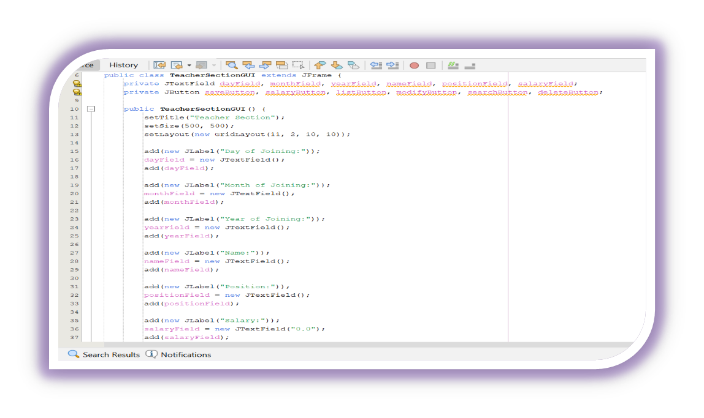
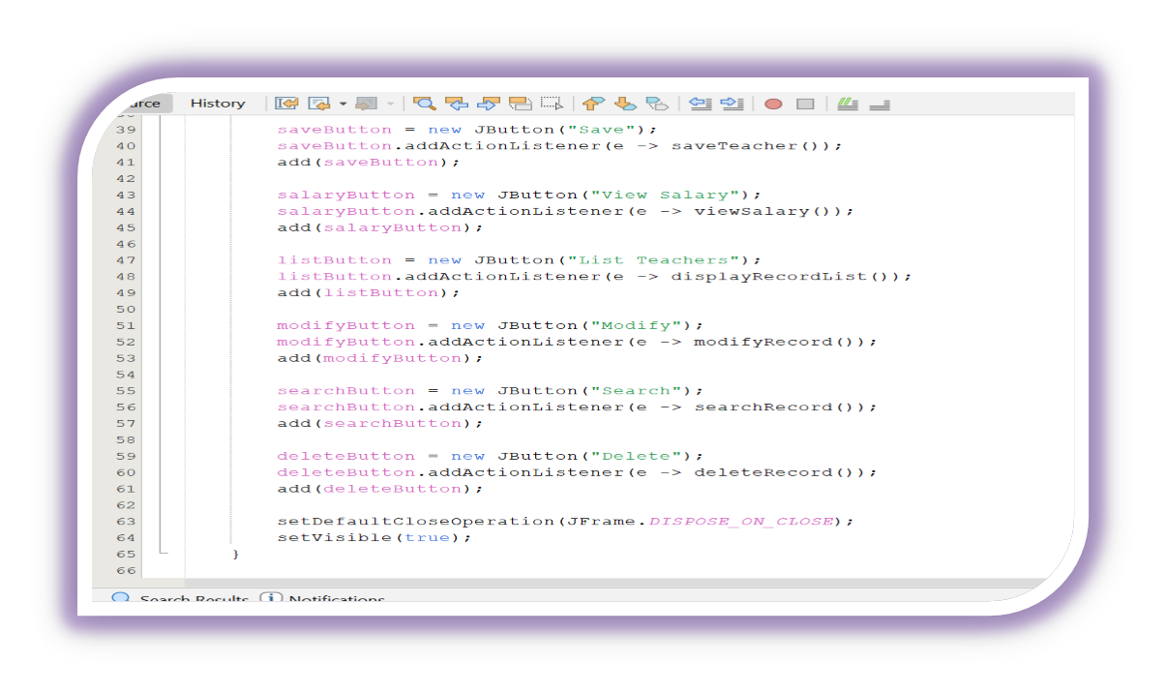

Slide 19
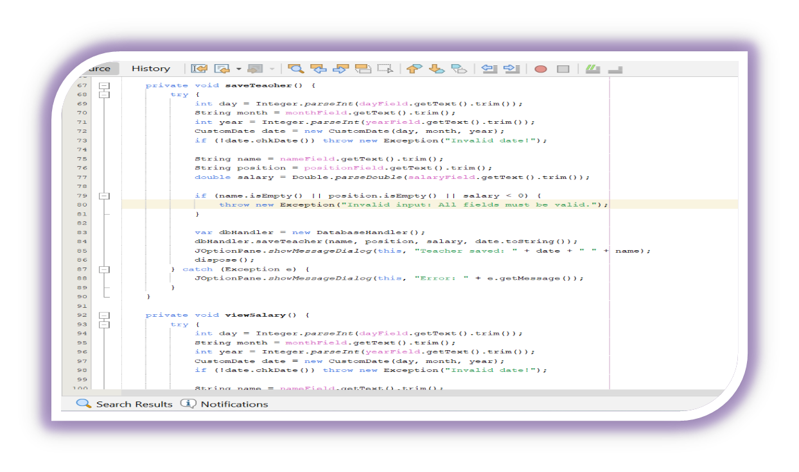
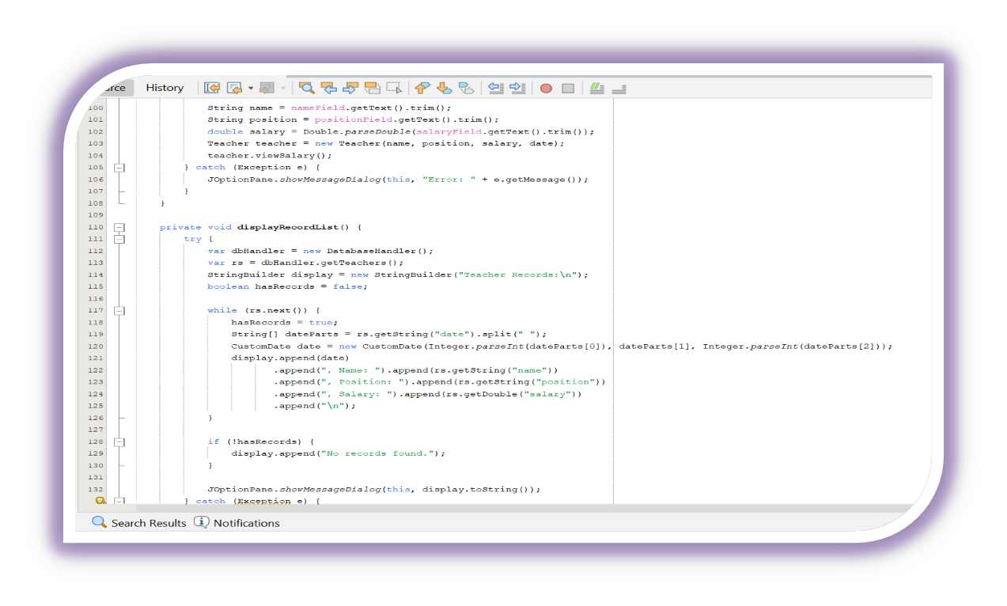

Slide 20
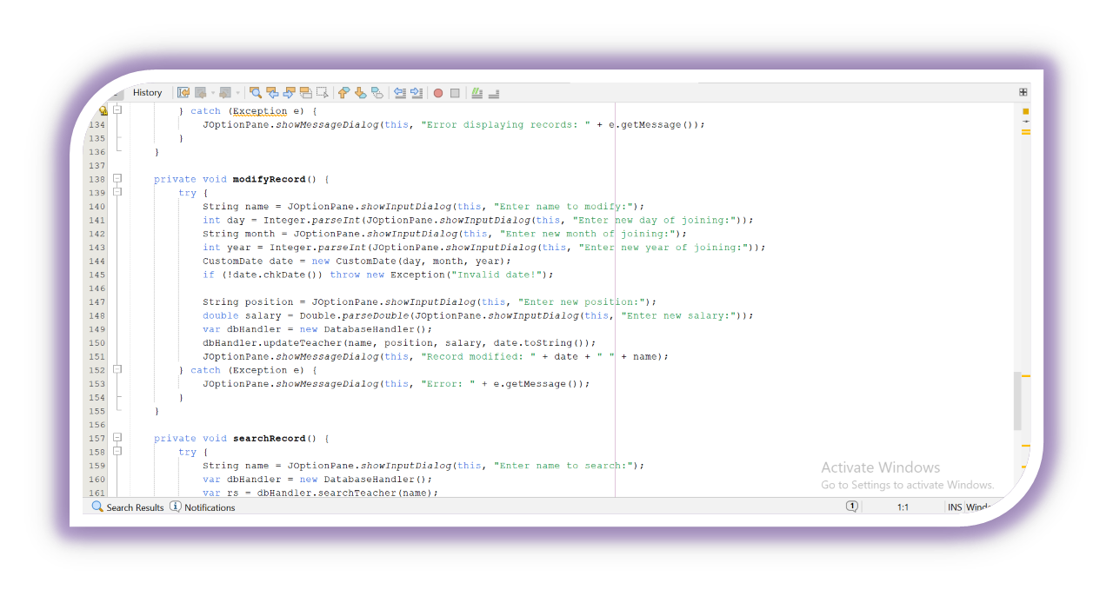
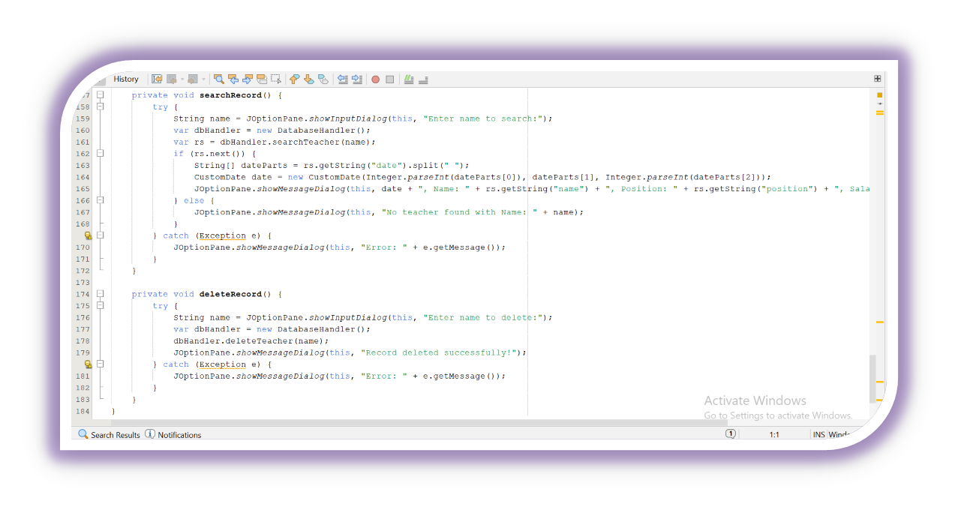

Slide 21
8. Student
Role: Manages student records and calculates fees.
Purpose: Tracks student information in the database and computes fee details such as due amounts, fines, and advances, supporting financial oversight within the educational system.

Slide 22
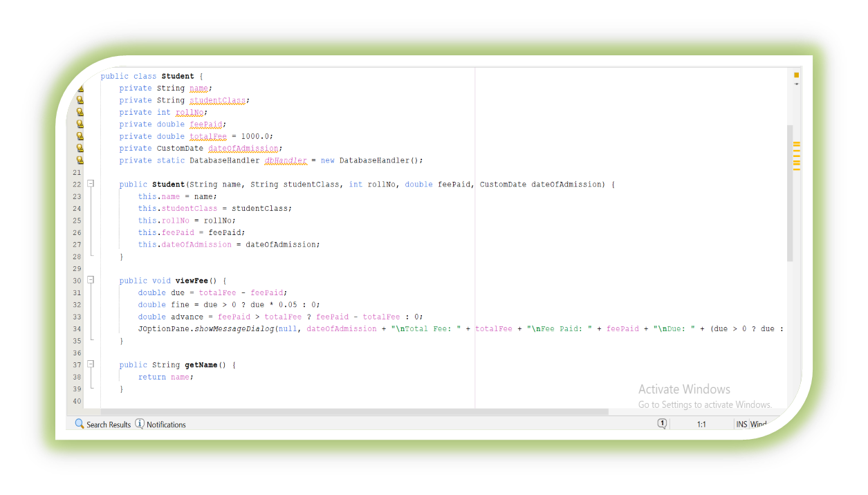
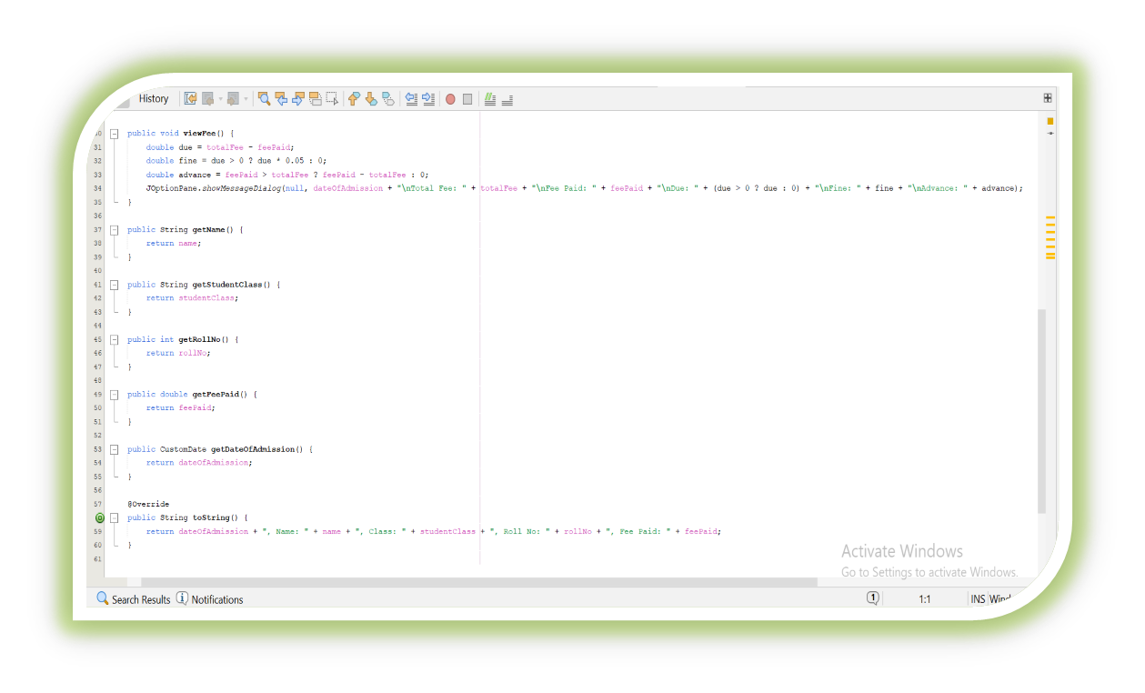

Slide 23
9. StudentSectionGUI
Role: Offers a GUI for student record management.
Purpose: Facilitates the handling of student data and displays fee-related information, enabling users to manage records efficiently and access financial details with ease.

Slide 24
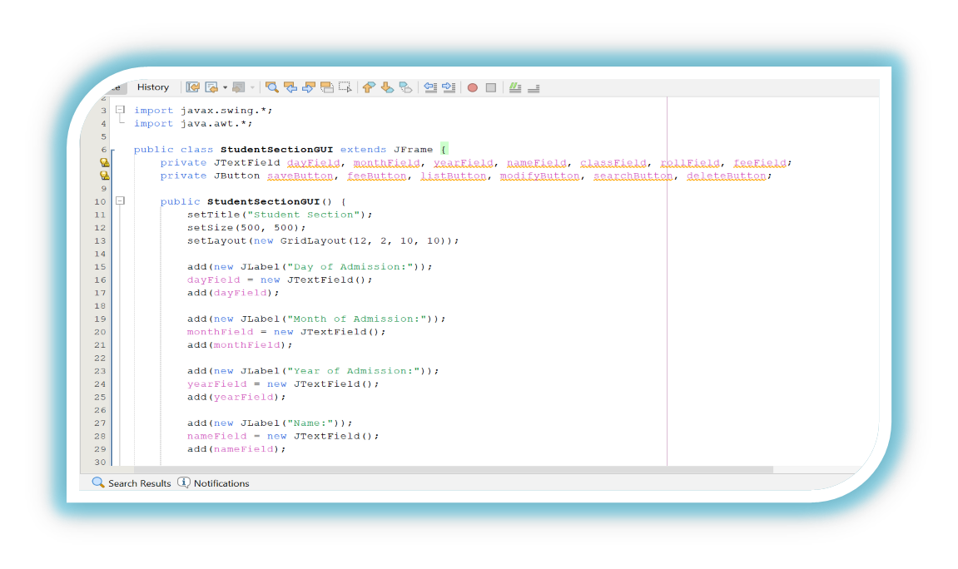
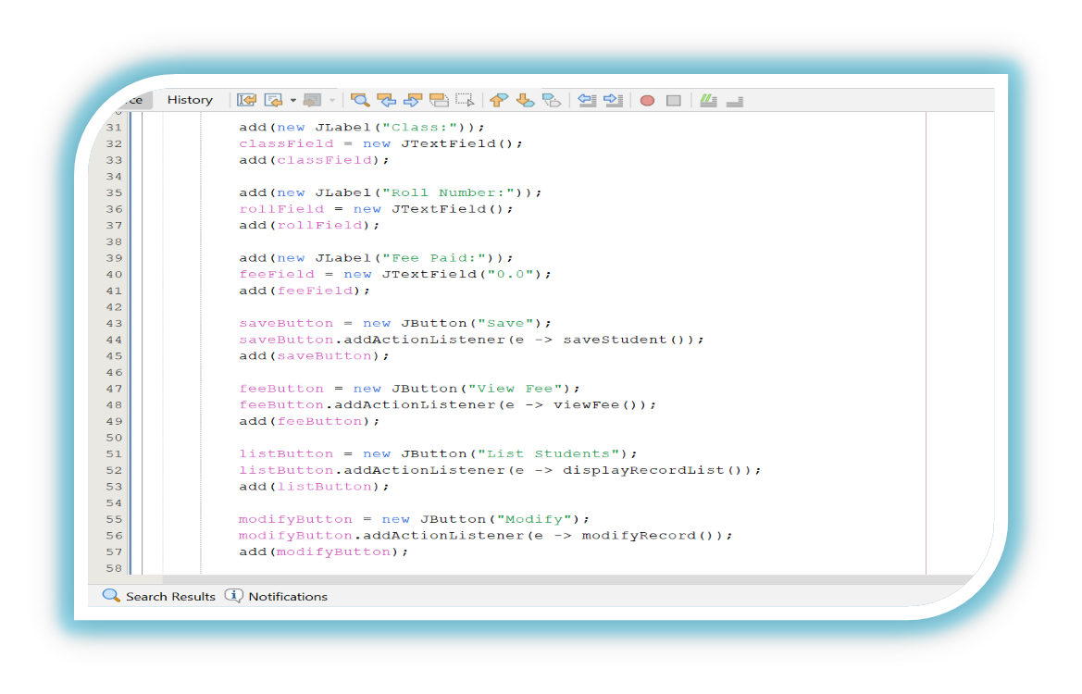

Slide 25
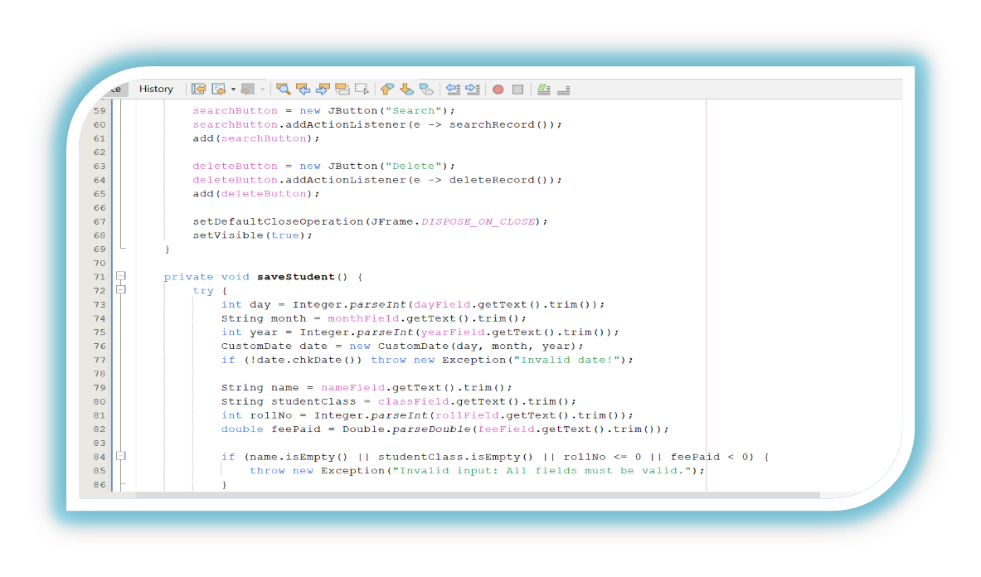
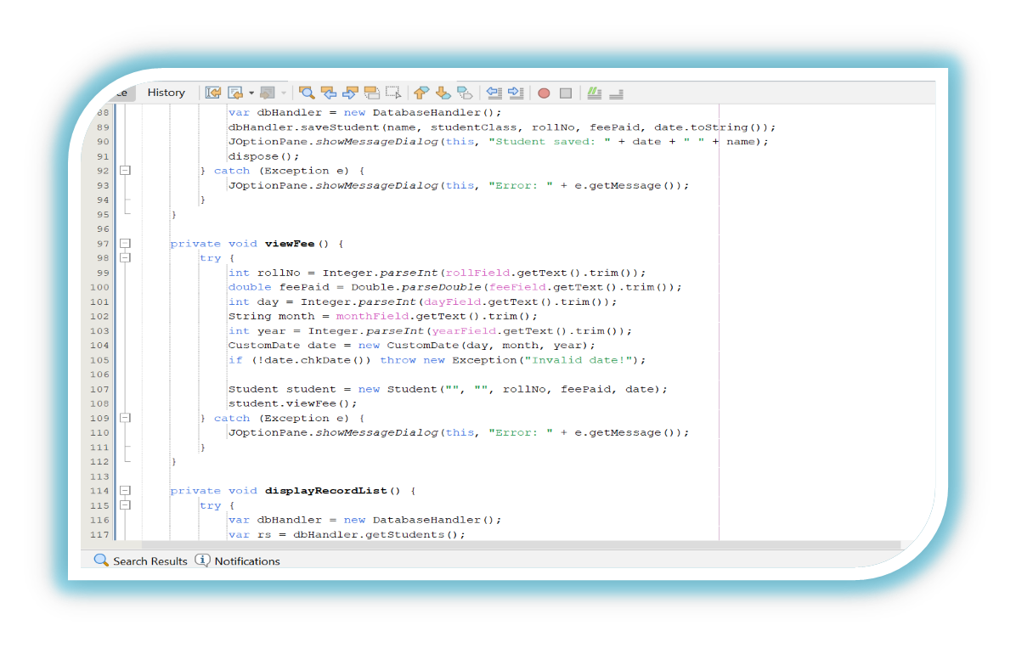

Slide 26
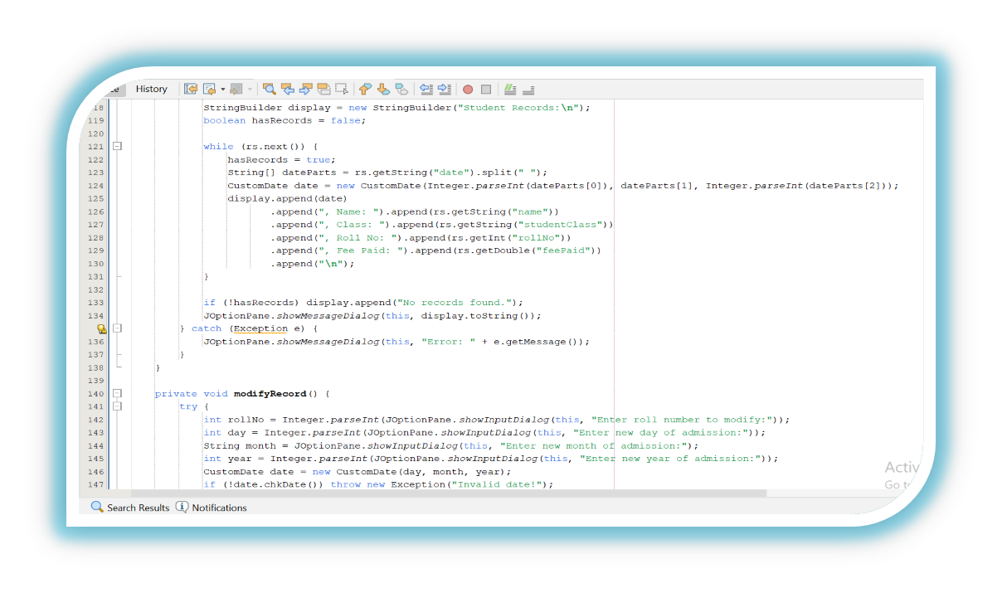
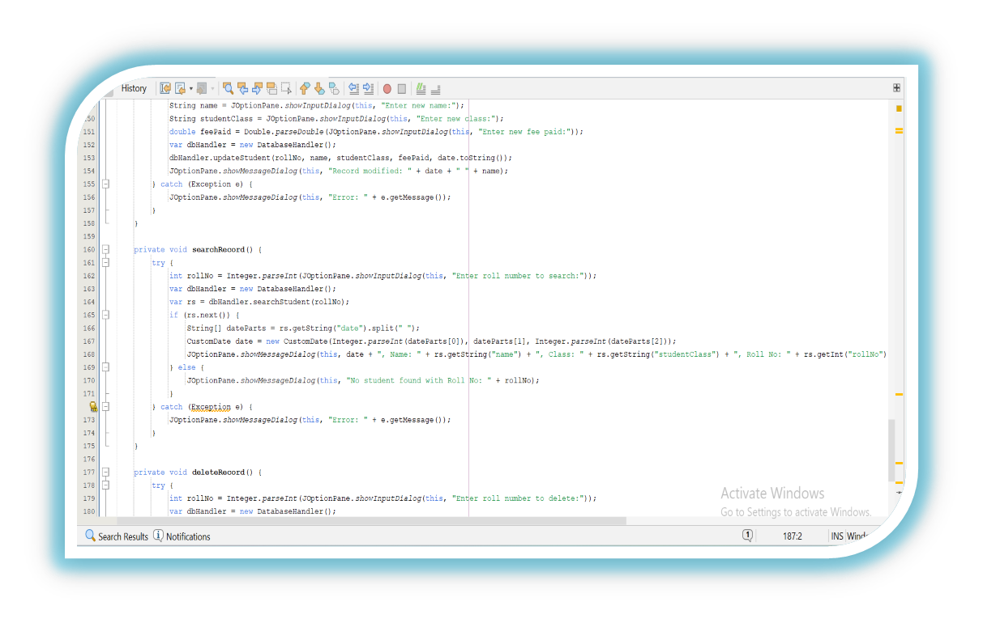

Slide 27
